Slide 1
Event Handling in Spring
The core of Spring is the ApplicationContext, which manages the complete life cycle of the beans.
The ApplicationContext publishes certain types of events when loading the beans. For example, a ContextStartedEvent is published when the context is started and ContextStoppedEvent is published when the context is stopped.
Event handling in the ApplicationContext is provided through the ApplicationEvent class and ApplicationListener interface. Hence, if a bean implements the ApplicationListener, then every time an ApplicationEvent gets published by the ApplicationContext, that bean is notified.
Spring's event handling is single-threaded so if an event is published, until and unless all the receivers get the message, the processes are blocked and the flow will not continue. Hence, care should be taken when designing your application if the event handling is to be used.
Application Context
Application Listener
Publish
Application Event(e.g ContextStartedEvent, ContextStoppedEvent
Receive

Slide 2
Event Handling in Spring
ContextStartedEvent
This event is published when the ApplicationContext is started using the start() method on the ConfigurableApplicationContext interface. You can poll your database or you can restart any stopped application after receiving this event.
ContextStoppedEvent
This event is published when the ApplicationContext is stopped using the stop() method on the ConfigurableApplicationContext interface. You can do required housekeep work after receiving this event.

Slide 3
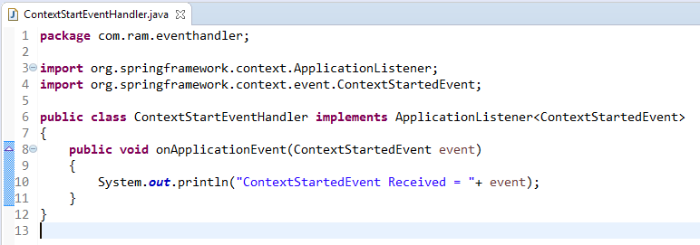
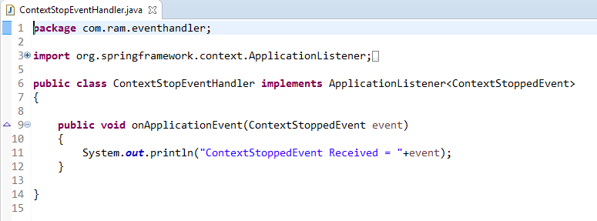
Event Handling in Spring
To listen to a context event, a bean should implement the ApplicationListener interface which has just one method onApplicationEvent().

Slide 4
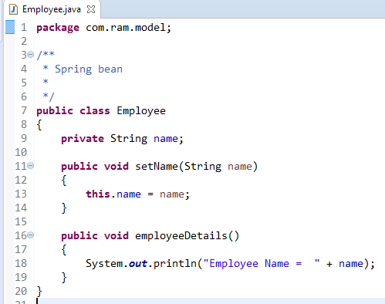
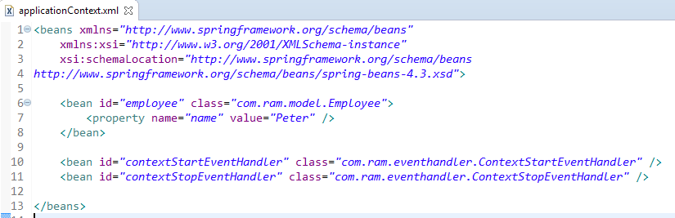
Event Handling in Spring

Slide 5
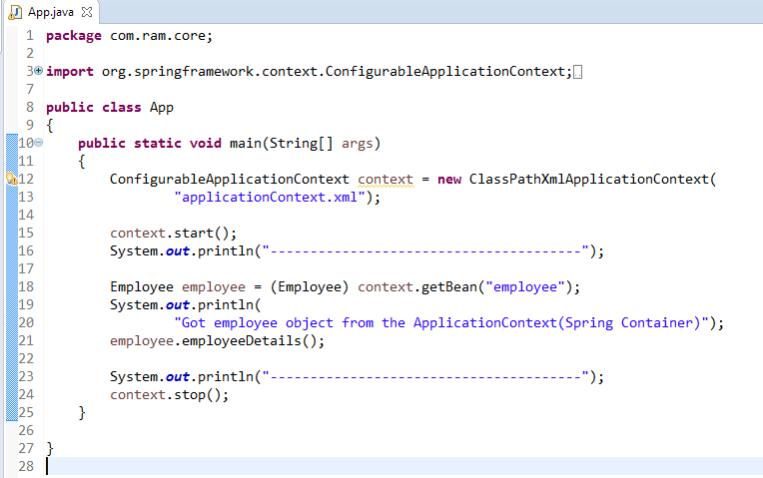
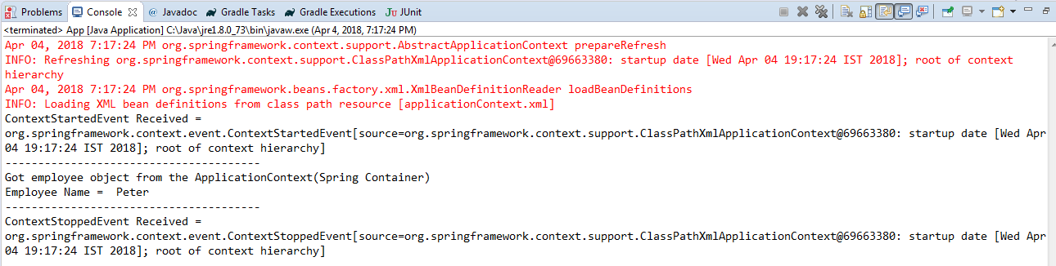
Event Handling in Spring

